Slide 1
FY18/9 Budget Development Update
Special School Board Meeting
December 7, 2017

Slide 2
Topics
Budget Survey + Budget Stakeholder Meeting
Local Composite Index (LCI) Update
Health Care Savings Update

Slide 3
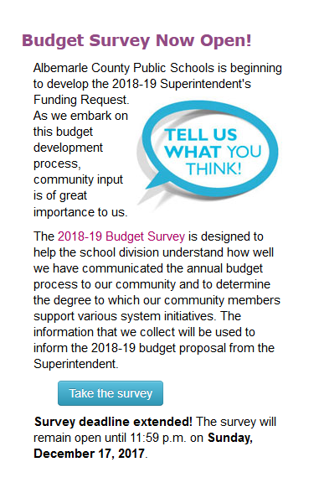
Budget Survey
Currently live with responses due 12/17
2,100+ responses to date
Take Survey Here

Slide 4
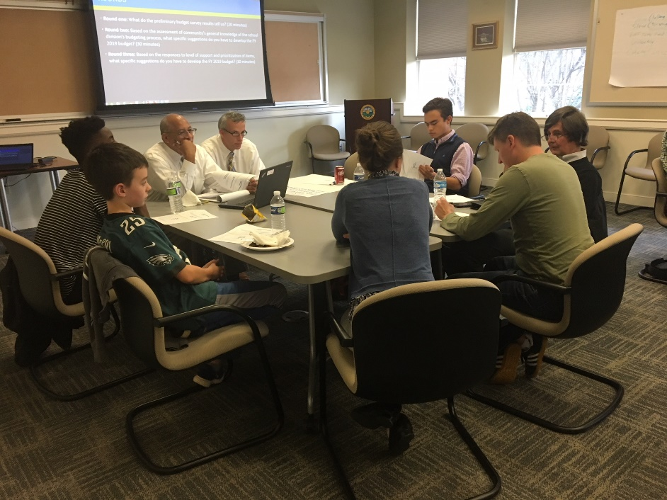

Budget Stakeholder Focus Group
Meeting hosted on Tuesday, December 5th
20+ Participants
Representatives from:
  Teach Advisory Committee
  Employee Advisory Committee
  Financial Advisory Committee
  Parent Council
  Student Council
  Strategic & Planning Cabinets

Slide 5
Composite Index of Local Ability-to-Pay
Calculated every biennium. Used by Virginia Department of Education (DOE) to calculate the state share of projected school division payments for the Governor’s budget.
Factors used to calculate include:
  True Values
  Adjusted Gross Income
  Taxable Retail Sales
  Population
  ADM
  Albemarle’s index increased by 6%. This is estimated to equate to $2-3M less than previously anticipated in the five year forecast.

Slide 6
Composite Index of Local Ability-to-Pay
Formula = [(.6667 x ADM Component) + (.333 x Population Component)] x 0.45
Average Daily Membership (ADM) Component:
Population Component:

Slide 7
Trend Analysis: Change from 2016-18 to 2018-20
LCI Factor | Division | Absolute % Change | Division vs. State Average Change
Average Daily Membership* | Albemarle | 2.04% | 266
 | State Average | 0.85% | 77
Population | Albemarle | 2.26% | 2320
 | State Average | 1.48% | 908
LCI Factor | Division | Absolute % Change | Per ADM % Change | Per Capita % Change
True Value of Property | Albemarle | 5.55% | 3.44% | 3.22%
 | State Average | 3.82% | 2.95% | 2.30%
Adjusted Gross Income | Albemarle | 27.86% | 25.30% | 25.04%
 | State Average | 10.78% | 9.84% | 9.16%
Taxable Retail Sales | Albemarle | 6.66% | 4.53% | 4.31%
 | State Average | 5.95% | 5.06% | 4.40%
Final Index Comparison
Division | 2016-18 | 2018-20
Albemarle | 0.6394 | 0.6780
*2014 – 2016 difference,
other factors are 2013-15 differences

Slide 8
Per Pupil State Revenues
Since FY 08-09, per pupil state aid* may decline by $562 per student
*Adjusted for Inflation (2008 Dollars)

Slide 9
Health Care Savings
The plan had favorable claim experience last year which is continuing.
There are projected savings in current plan year and next year. Exact figures TBD.

